Slide 1
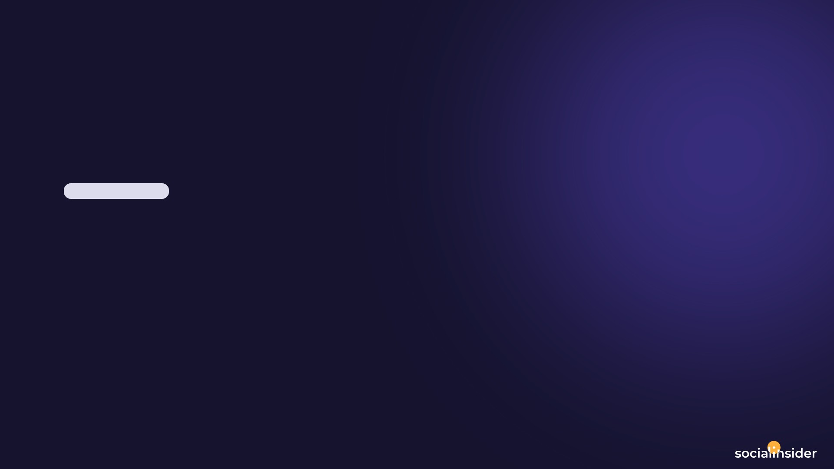
GIRIZEVERMAHAL_1990
Instagram Report
BRAND
PERIOD
COMPARISON PERIOD
CHANNEL
@girizevermahal_1990
20 Jun 2026 - 19 Jul 2026
21 May 2026 - 19 Jun 2026
Instagram

Slide 2

Giri Zever Mahal
EXECUTIVE SUMMARY
2/12
Between June 20 and July 19, 2026, GiriZeverMahal's Instagram profile experienced notable growth and engagement improvements. The follower count grew to 442,235, adding 5,155 new followers, although the growth rate slowed compared to the previous period.The content output increased to 40 posts, including Reels, which saw significant interaction growth with total engagement reaching 270,242, up substantially from before. Engagement rates per post and per follower also rose sharply, indicating that the audience is interacting more actively with the content.Videos performed well, accumulating over 18 million views, contributing to wider reach and impressions that surged to over 18.6 million. Delivered earned media value rose impressively, reflecting the enhanced visibility and influence of the profile.While the average hashtags per post slightly decreased, other engagement metrics such as likes and comments per post more than tripled, painting a picture of growing community involvement.
Source: Socialinsider
Date range: 20 Jun 2026 - 19 Jul 2026

Slide 3
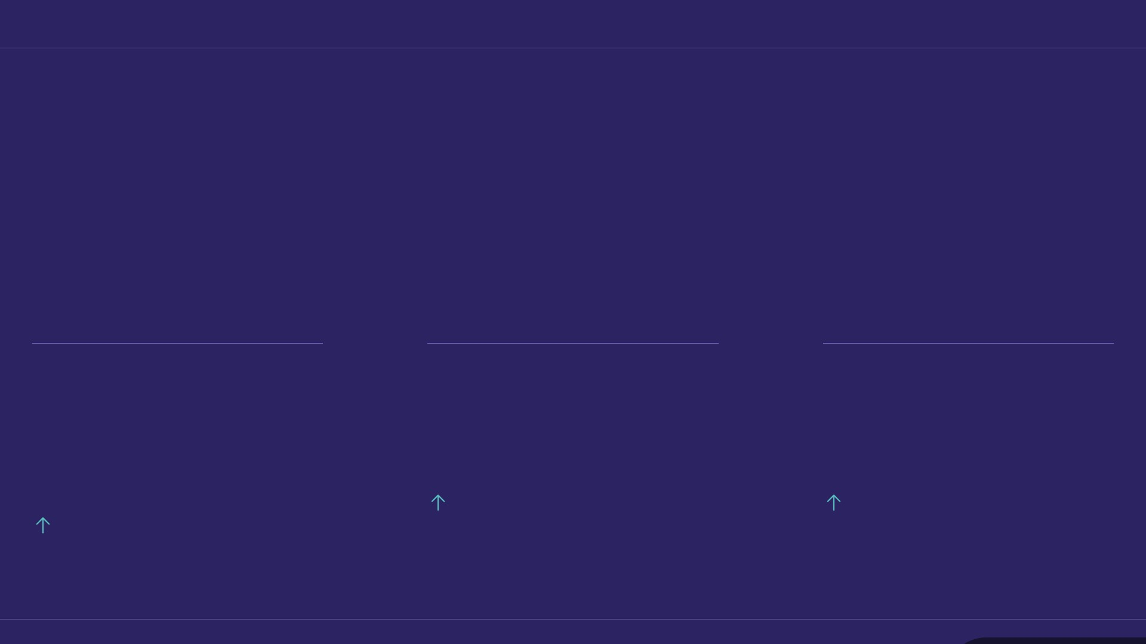
KEY INSIGHTS
3/12
One month, three numbers
A strong period — most metrics moved in the right direction.
1.53 %
18.6M
11.6M
Avg. Engagement Rate by Followers
Organic Posts Views
Organic Posts Reach
625.03%
625.03%
371.8%
Source: Socialinsider
Date range: 20 Jun 2026 - 19 Jul 2026

Slide 4
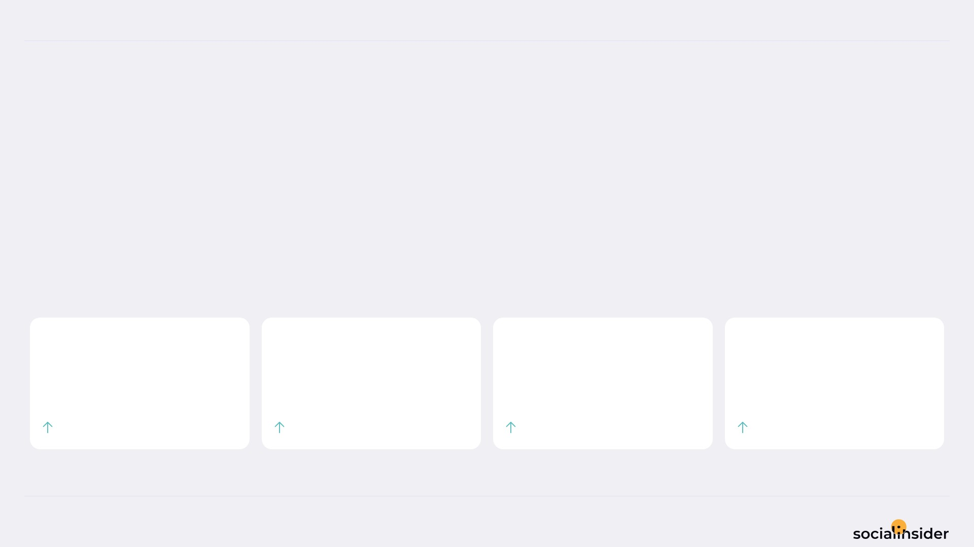
Giri Zever Mahal
POSTS PERFORMANCE
4/12
POSTS TO ENGAGEMENT
We posted 14.29% more, and got 446.21% more engagement.
The engagement gain ran 31.2x ahead of the output increase. Quality compounded.
TOTAL POSTS
TOTAL ENGAGEMENT
AVG ENGAGEMENT / POST
AVG ENGAGEMENT / DAY
40
270.2K
6,756
9,008
14.29%
446.21%
377.93%
446.21%
Source: Socialinsider
Date range: 20 Jun 2026 - 19 Jul 2026

Slide 5
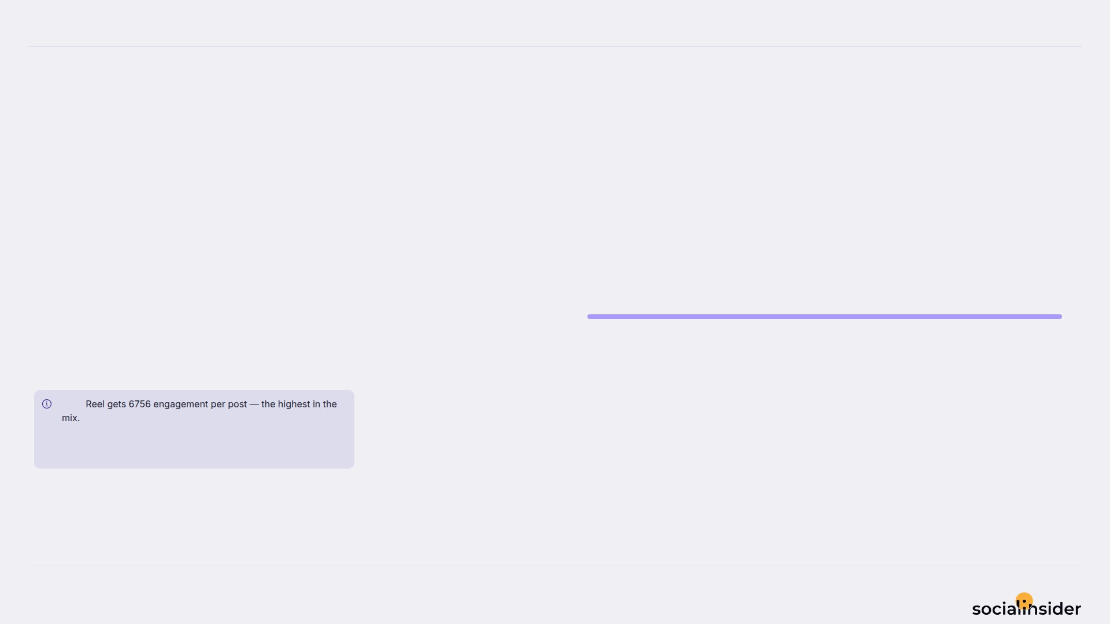
Giri Zever Mahal
5/12
WHAT WE PUBLISHED
Reel made up the majority of posts published during this period.
Reel
40
Reel accounted for 100% of posts and 100% of engagement.
Note
Source: Socialinsider
Date range: 20 Jun 2026 - 19 Jul 2026

Slide 6
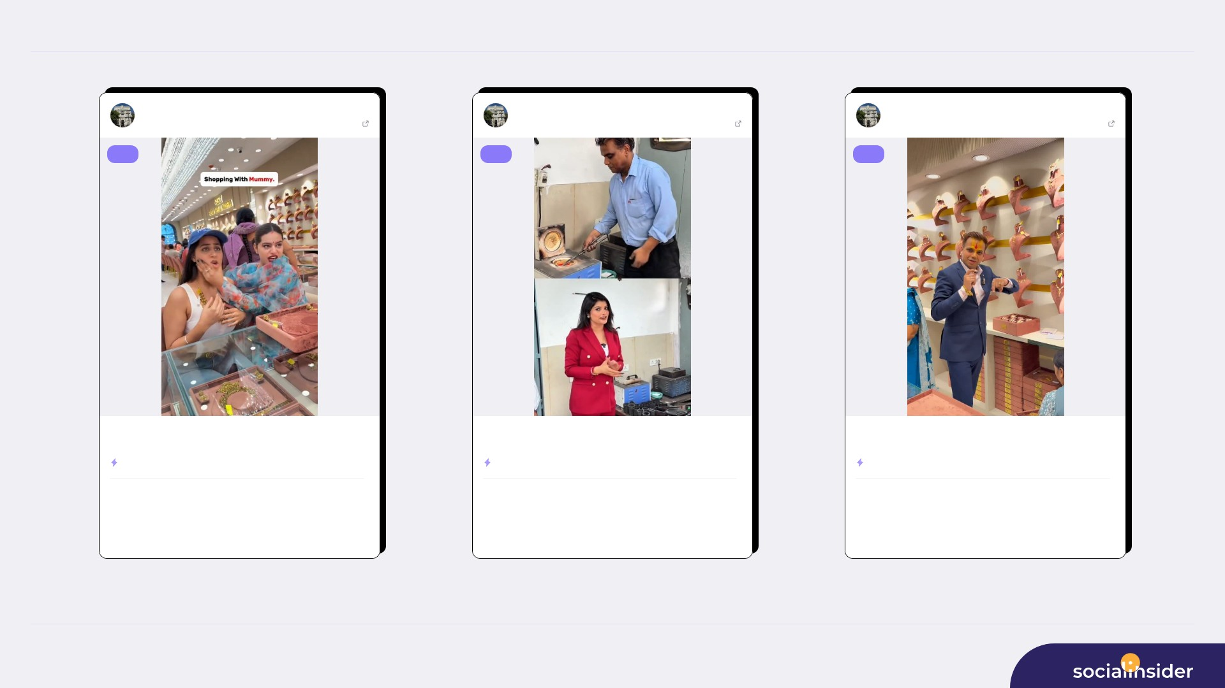
TOP CONTENT
6/12
Giri Zever Maha...
Jul 03, 2026
Giri Zever Maha...
Jul 14, 2026
Giri Zever Maha...
Jul 09, 2026
442235 followers
View post
442235 followers
View post
442235 followers
View post
reel
reel
reel
Shopping with Mother😍👉Get 2% Making Charges on OLD GOLD EXCHANGE, Of...
Get 2% Making Charges on OLD GOLD EXCHANGE, Offer for Next 15Days🏦 In...
Get 2% Making Charges on OLD GOLD EXCHANGE, Offer for Next 15Days🏦 In...
ENGAGEMENT RATE
44.60%
ENGAGEMENT RATE
2.46%
ENGAGEMENT RATE
1.89%
14.6M
196.7K
338.7K
10.9K
358.6K
7,954
VIEWS
LIKES
VIEWS
LIKES
VIEWS
LIKES
504
9.1M
27
211K
419
223.4K
COMMENTS
REACH
COMMENTS
REACH
COMMENTS
REACH
Source: Socialinsider
Date range: 20 Jun 2026 - 19 Jul 2026

Slide 7
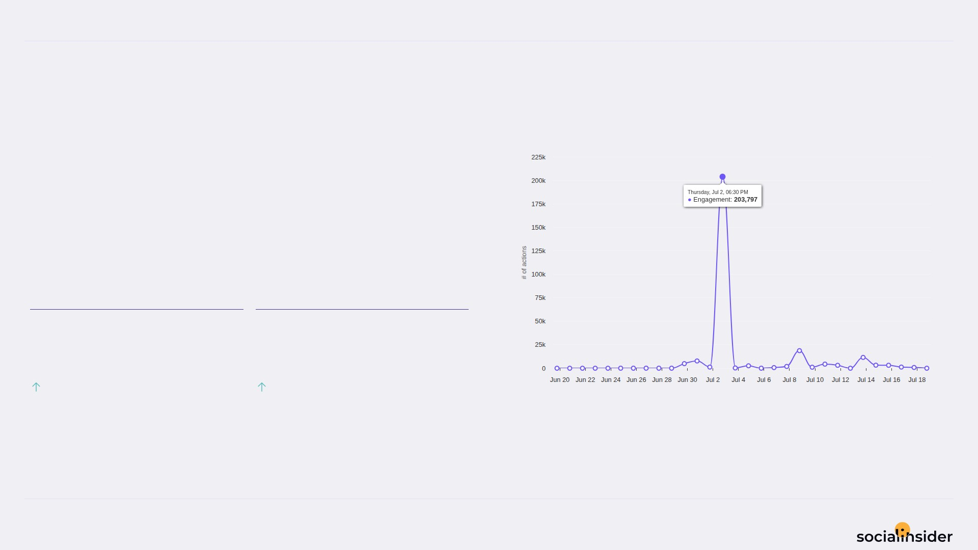
Giri Zever Mahal
ENGAGEMENT
7/12
Engagement trend over the selected period
268.5K Total Organic Likes — holding steady.
Both Total Organic Likes and Total Organic Comments improved this period.
TOTAL ORGANIC LIKES
TOTAL ORGANIC COMMENTS
268.5K
1,738
451.46%
121.12%
Source: Socialinsider
Date range: 20 Jun 2026 - 19 Jul 2026

Slide 8
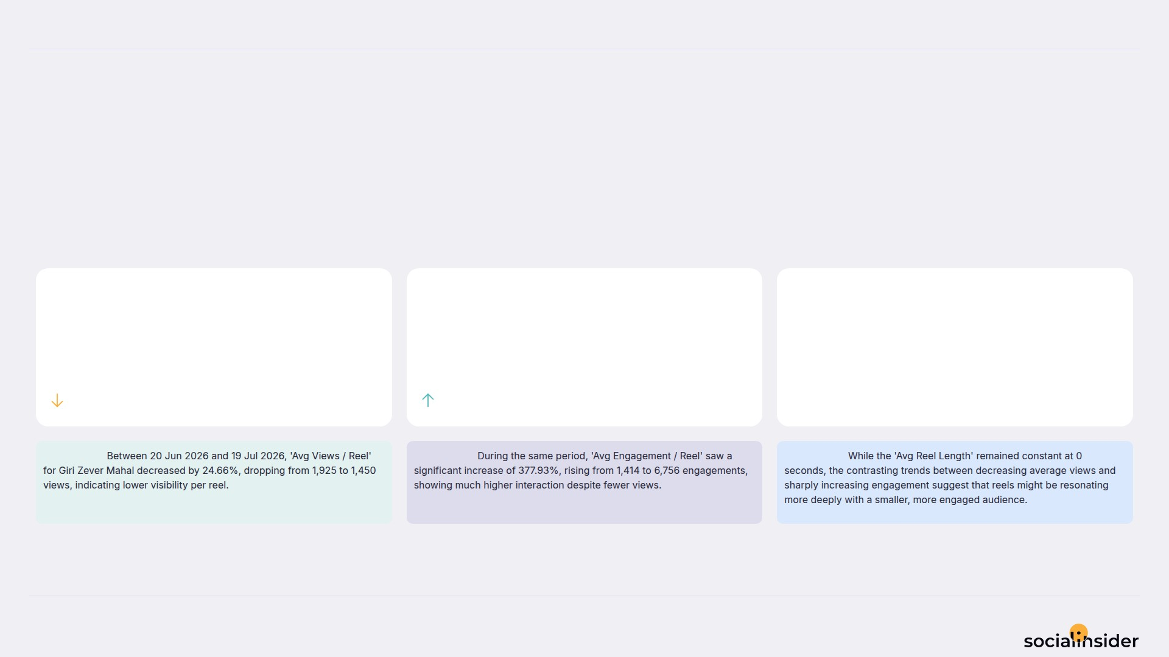
Giri Zever Mahal
REELS
8/12
Key metrics for reels published during the period
Reels was mixed — some metrics increased while others decreased.
AVG VIEWS / REEL
AVG ENGAGEMENT / REEL
AVG REEL LENGTH
1.5
6,756
0
24.66%
377.93%
0%
Observation:
Observation:
Observation:
Source: Socialinsider
Date range: 20 Jun 2026 - 19 Jul 2026

Slide 9
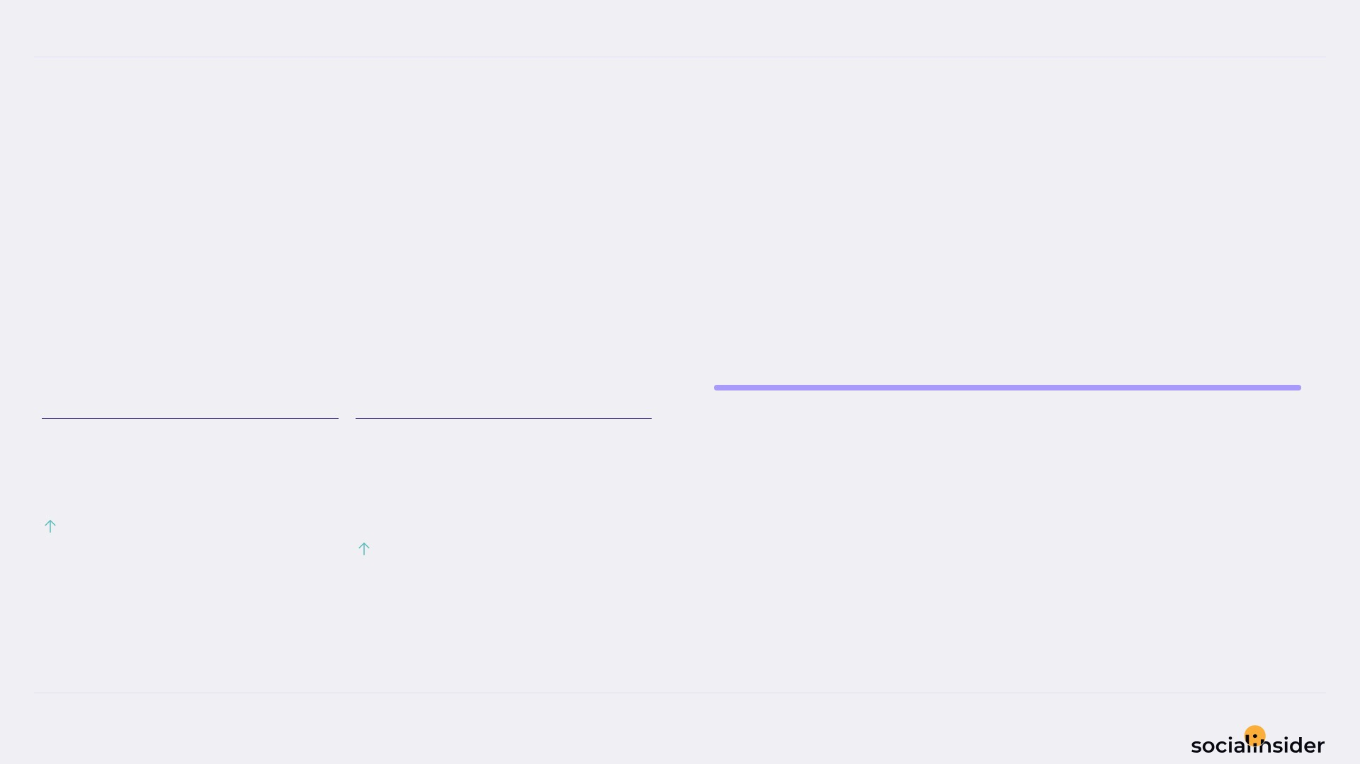
Giri Zever Mahal
REACH
9/12
Reach performance broken down by post type
290.2K Avg Reach / Post — holding steady.
Both Avg Reach / Post and Avg Engagement Rate by Reach improved this period.
Reel
11.6M
AVG REACH / POST
AVG ENGAGEMENT RATE BY REACH
290.2K
2.4
%
625.03%
5.32%
Source: Socialinsider
Date range: 20 Jun 2026 - 19 Jul 2026

Slide 10
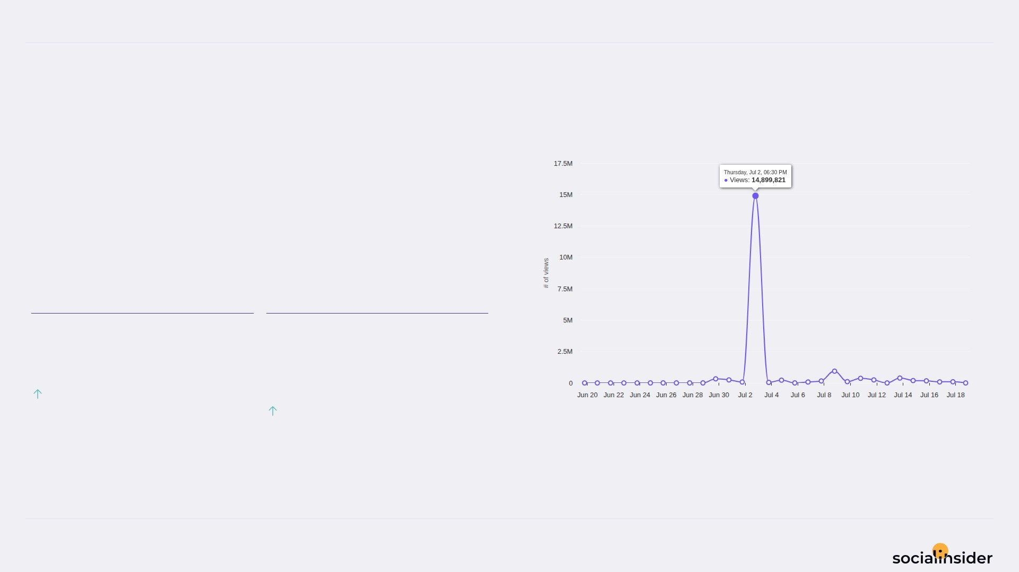
Giri Zever Mahal
VIEWS
10/12
Views performance
465.8K Avg Views / Post — holding steady.
Both Avg Views / Post and Avg Engagement Rate by Views improved this period.
AVG VIEWS / POST
AVG ENGAGEMENT RATE BY VIEWS
465.8K
1.5
%
534.4%
5.32%
Source: Socialinsider
Date range: 20 Jun 2026 - 19 Jul 2026

Slide 11
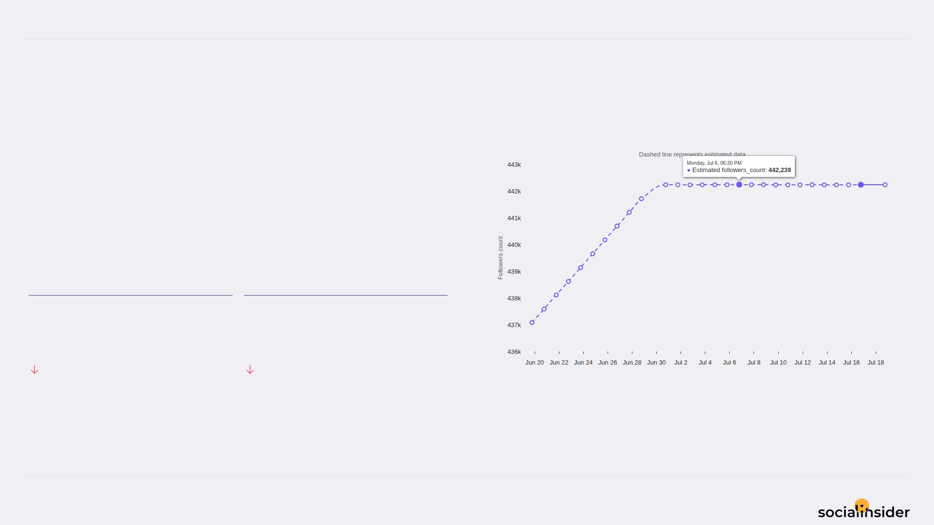
Giri Zever Mahal
FOLLOWERS
11/12
Follower growth trend over the selected period
5155 Follower Growth — holding steady.
Both Follower Growth and Followers Growth % declined this period.
FOLLOWER GROWTH
FOLLOWERS GROWTH %
5,155
1.2
56.57%
57.8%
Source: Socialinsider
Date range: 20 Jun 2026 - 19 Jul 2026

Slide 12

REFERENCE
12/12
Definitions and reference materials for this report
Glossary & Resources
Scope
Definitions
Resources
Period
Engagement
Socialinsider Blog
20 Jun 2026 - 19 Jul 2026
The sum of likes and comments on the organic posts
socialinsider.io/blog
Comparison Period
Engagement Rate by Followers
Socialinsider Help Center
21 May 2026 - 19 Jun 2026
Engagement divided by follower count, expressed as a percentage
https://howto.socialinsider.io/en/
Social Channel
Reach
Socialinsider Studies
Instagram
Number of unique accounts that saw your content
https://www.socialinsider.io/reports
Content Analysis (posts analyzed)
Views
40
Total number of times your content was displayed
Source: Socialinsider
Date range: 20 Jun 2026 - 19 Jul 2026

